Slide 1
The English Language as a Tool of Writing a Computer Test Program “Art” “Art”
Carried out by:
Daniil Santotskiy

Slide 2
This topic is relevant due to rapid computerization of our society. More and more people use computer in their professional activities, at school, in everyday life and for entertainment.

Slide 3
The objective of the research:
To study information on how to write computer programs and coding languages that can be used;
To continue to improve knowledge in the English language as well as IT.

Slide 4
The goals of the work
To analyze the importance of knowing the English language in writing a computer program;
To write a computer program

Slide 5
The tasks of the research:
To study the types of computer programs and programming languages;
To develop skills to select and systematize materials for observation;
To interview IT specialists around the world;
To improve skills of working with scientific and reference literature in both Russian and English;
To continue to improve communicative skills.

Slide 6
The object of the study:
Computer programs and coding languages.

Slide 7
The subject of the research:
The research of writing a computer program for teenagers using English.

Slide 8
Research hypothesis:
You need to know English in order to write a computer program.
Writing it knowing English makes coding easier to understand and the program worth using.

Slide 9
The novelty of this work lies in the fact that this topic is studied by us for the first time in the theoretical and practical sense as the interest to this field of computer is growing these days. Today, intellectually developed, sociable, competitive professionals who are able to produce the necessary knowledge are in demand on labor market.

Slide 10
Programming Languages:
JavaScript
Java
PHP
Python
С++
Ruby
CSS
Objective-C
Shell
Perl
Visual Basic

Slide 11
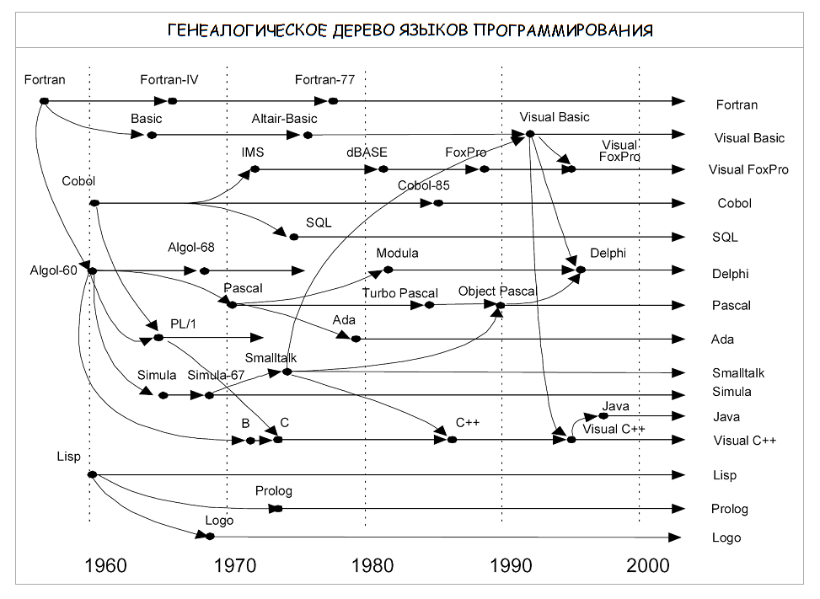
Geological tree of all programming languages and their development throughout history.

Slide 12
Delphi
Delphi programming language is a programming language that is used in the development field of the same name and is a combination of several important technologies:
high-performance compiler in machine code;
object-oriented component model;
visual (and, consequently, high-speed) construction of applications from software prototypes;
scalable tools for building databases.

Slide 13
Educational Computer Programs for Learning English
Lingualeo,
Duolingo,
Words,
Easy ten,
Memrise,
Anki,
FluentU,
HelloTalk,
English Grammar Test,
And others

Slide 14
Research Part. Steps of Writing a Computer Program
Specification (definition of requirements to the program);
Algorithm development;
Coding;
Stages of program development. Debug;
Testing;
Creating a help system;
Create an installation disc (CD-ROM).

Slide 15
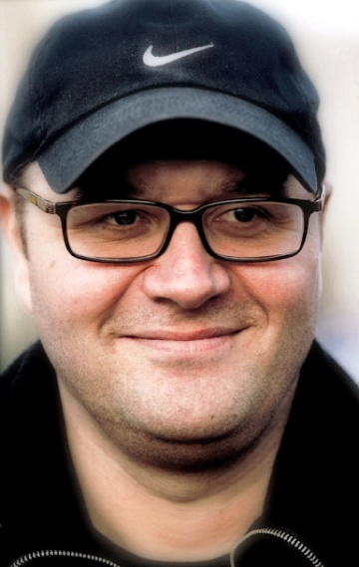
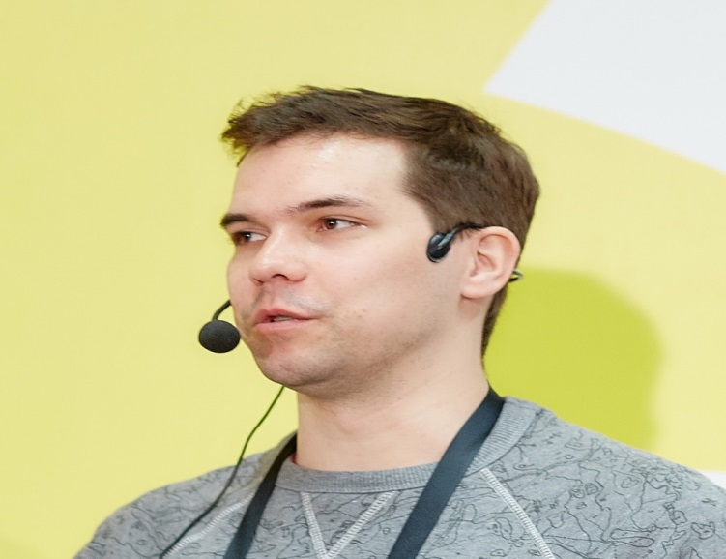
IT Specialists’ Opinions and Interview
Dmitry Soshnikov, Microsoft technology Evangelist, an associate Professor of MIPT, MAI, and a teacher of children's camp JUNIOR
Lack of knowledge of English is critical for any modern person working in creative field. After all, without the language you limit your circle of communication leaving only Russian-speakers, when there are many active talented people around the world. It should also be taken into account that most of the best courses, reference and training materials are available in English. Therefore, it is better to learn the language well once, and then to improve it on the forums.
Vsevolod Shmyrov, a developer in Yandex API team.Maps
No. Knowledge of the language at a basic level is necessary. School-level is enough to read Stack Overflow. But without additional practice you will not be able to learn the language.

Slide 16
Video interview with an IT specialist
Raul, Colombia.mkv

Slide 17
Questionnaire
How old are you?
Do you study or did you study English or any other foreign language at school? Do you study or did you study any foreign language at school?
What foreign language do you think you should know in order to be able to understand foreigners?
Have you tried to write a computer program?
Would you like to write one?
In your opinion do you need to know English to write it?
Choose a topic that might be interesting for you?
What should this program have to interest you?

Slide 18
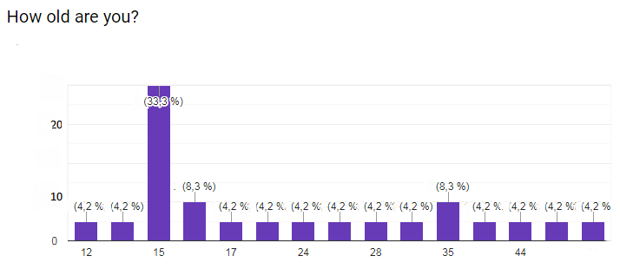
Questionnaire
1.

Slide 19
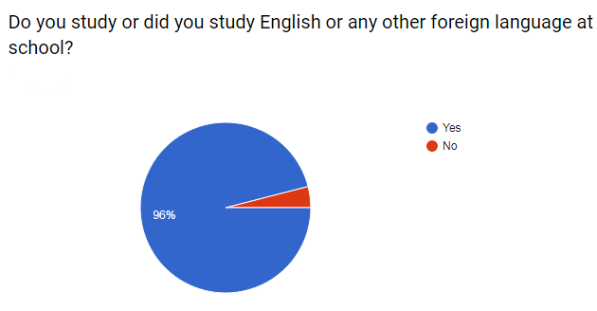
Questionnaire
2.

Slide 20
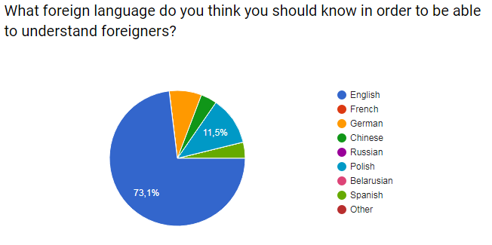
Questionnaire
3.

Slide 21
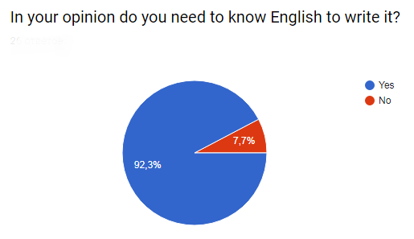
Questionnaire
6.

Slide 22
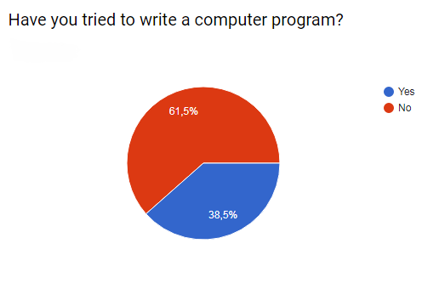
Questionnaire
4.

Slide 23
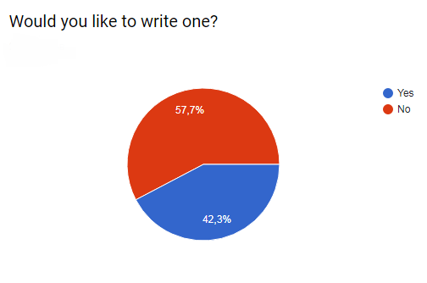
Questionnaire
5.

Slide 24
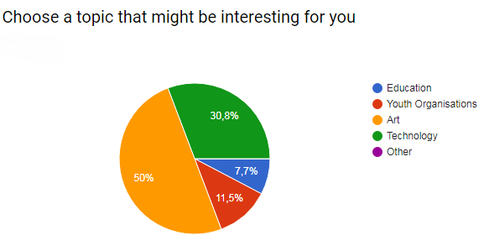
Questionnaire
7.

Slide 25
8.What should this program have to interest you?
The most popular answers were audio and video files, grammar, some interesting facts about art, something to widen horizons in the topic, useful functions and practical meaning, English chat free rooms, interesting and challenging exercises, interesting design, something helpful and simple; it should help in studies; it should teach how to draw a picture.

Slide 26
CODING of the program
1) Creating a user class and registration;
2) Writing the user name to the file and zeroing the rest of the file;
3) Creating a form and fill it, then let user answer the questions;
4) Next, the entry in file 1, in case of a correct answer and 0 in the opposite;
5) For the remaining sections (Vocabulary, Reading, Grammar, Exam) steps 4-5 were repeated;
6) Creating a form with the results;
7) Check the file for the number of units in each section and display;
8) Calculation of the primary result and output to the screen.
As a result of the creation of the application English Test all the above tasks have been solved.

Slide 27
PROGRAM
v 1.02\v 1.02\EnglishTest.exe

Slide 28
CONCLUSION
English is very important for the IT industry as a whole, as a fast-growing industry. Ignorance of the language significantly limits the programmer's development as a specialist, as it narrows his information field and circle of communication. It is no secret that a huge amount of information and documentation appears first in English.
Using a computer program is popular with our peers and is a good way to learn and improve your knowledge as well as test your skills. They’ve been gaining popularity for years and have become an essential part of everyday life.

Slide 29
Thank you for attention! Have a good day!

