Slide 1
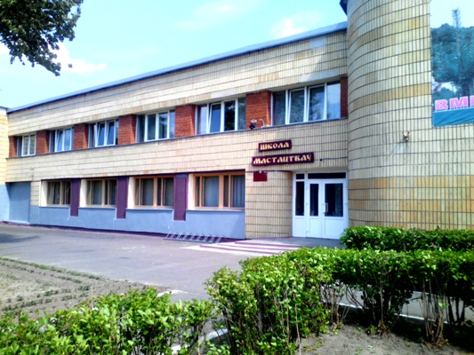
The State Educational Institution "Berezinsky Children's Art School" invites to cooperate in the framework of the humanitarian project "Creative PROmovement".

Slide 2
Project purpose: creating equal conditions for children and youth in rural areas in obtaining further education in the field of culture.
Project objectives:
1. Acquisition of a school bus –Gazel Next (18 places)
2. Implementation of the educational program of additional education of children and youth.
3.satisfying the need for additional education of children and youth in rural areas
4. forming the general culture and artistic development of children and youth
5.Increase the number of students of the institution of additional education of children and youth in rural areas in the field of culture.
Target audience:
rural students

Slide 3
Brief description of project activities:
1. Identify gifted children in rural areas
2. Organization of transportation of rural students to the city’s school of arts
3. creation of favorable conditions for the formation of music education, artistic and aesthetic education, intellectual and spiritual and moral development of children.
4. preparation of students for further vocational education in institutions of secondary special and higher education.

Slide 4
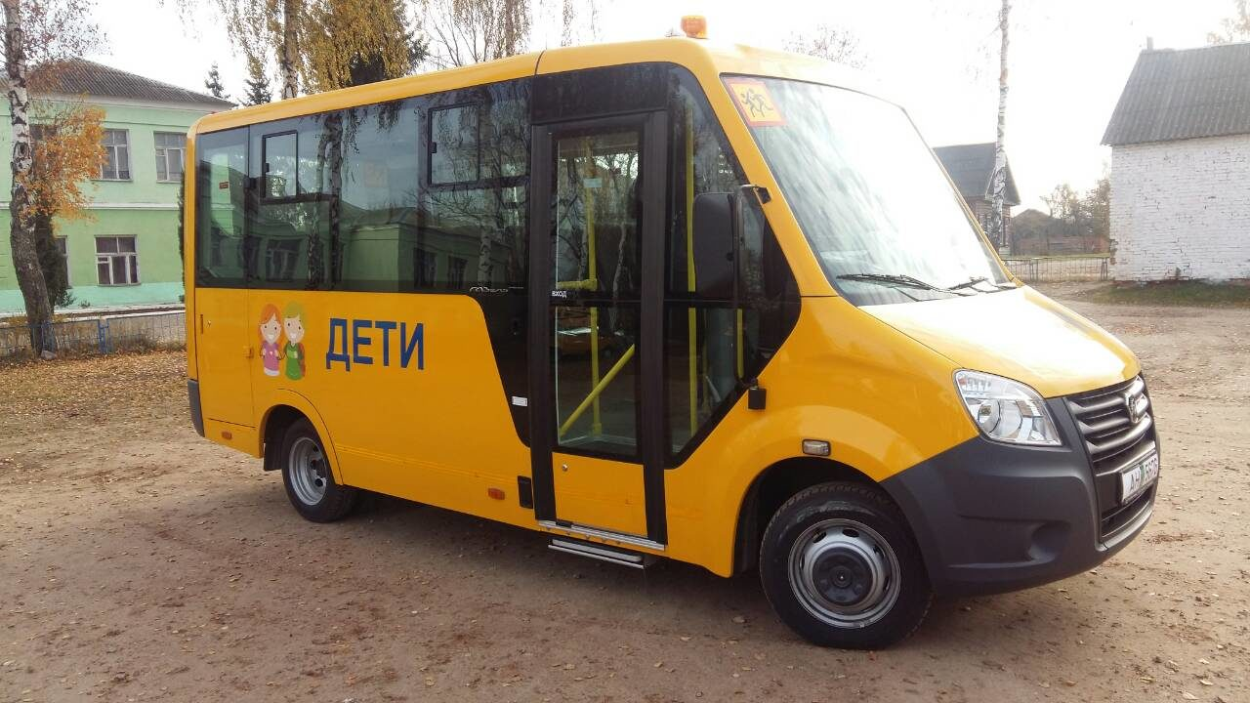
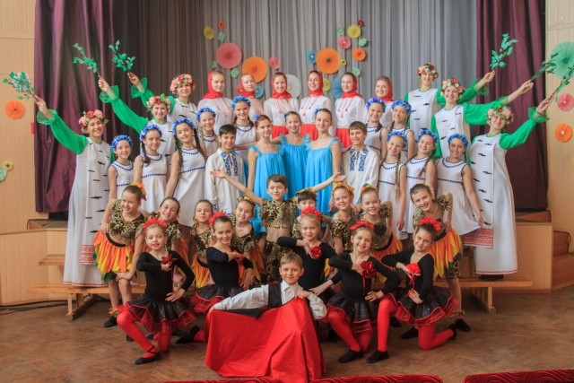
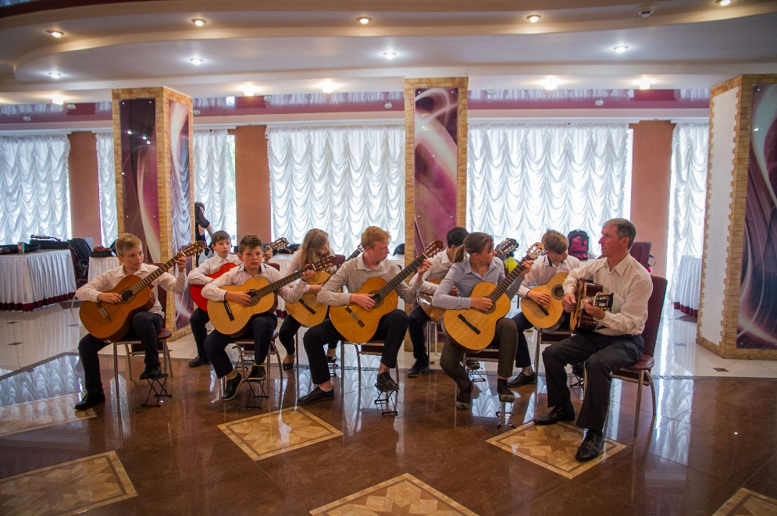

Slide 5
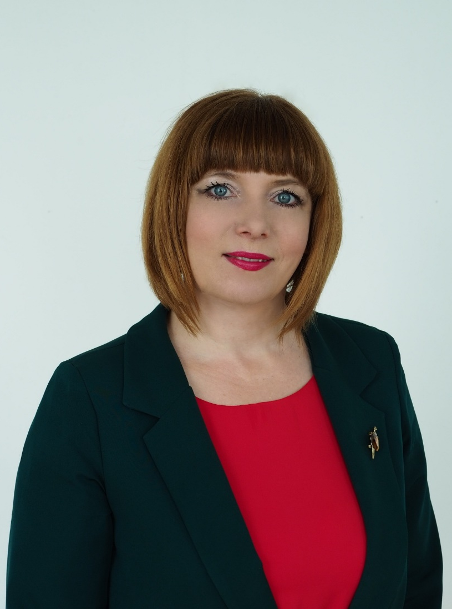
Project location:
Berezino district, Minsk region.
Contact person: Natalia Sliaptsova, director
Tel: 8(01715)5-56-36; +375297623341
E-Mail: sberezino@mail.ru
We look forward to collaborating!

