Slide 1
Презентация на тему: «There is no place like home.» 5 класс.
Подготовил: Павловский Игорь Викторович, учитель английского языка
ГУО «Жуховичская средняя школа»

Slide 2
There is no place like home
Letter secrets. Revision.
I = tIdy, nIce, fIne.
A = fAce, nAme, tAble.
O = bOnes, Rose, gO.
U = mUsic, SUsie.
I = Liz, sIx, kItten.
A = dAd, sAd, hAppy.
0 = dOg, stOp, frOg
U = pUppy, Lucky.

Slide 3
Billy GoOAt wore a cOAt going along the rOAd
oa

Slide 4
What sounds are the letters?
Remember the words with these letters.
OO CH AR AFT CK ALL IGH AY
TH AST
OR OU

Slide 5
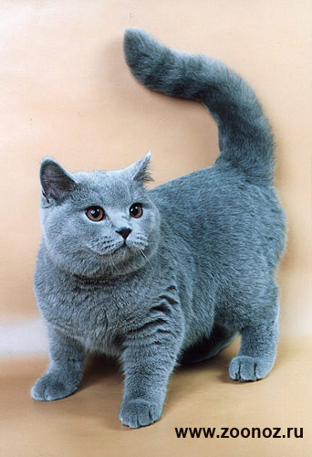
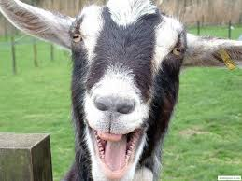
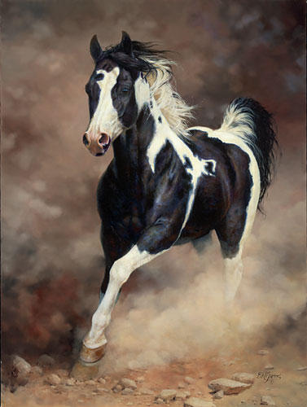
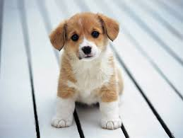
Look at the pictures and read the words

Slide 6
Read, please.
Look after – даглядаць( каго, што)
Dig – (капаць) - Dug
Catch – (лавіць) – Caught
Throw - ( кідаць) – Threw
Bring – ( прыносіць) - Brought

Slide 7
Listen and read the story.
What is fun for different animals? What is real fun for Jack?
Fun for Jack.

Slide 8
Explain the title of the lesson
?

Slide 9
Write 2-3 words from the text for each secret (ex.1a)
?
?
a
?
?
i

Slide 10
Complete and write the short story
This story is about……..

Slide 11
Thank you for your work.

